Slide 1
World Climate Zones
Each of the maps you will see represents the World Climate Zones in a different way.

Slide 2
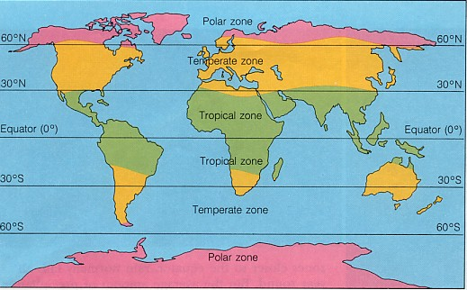

Slide 3
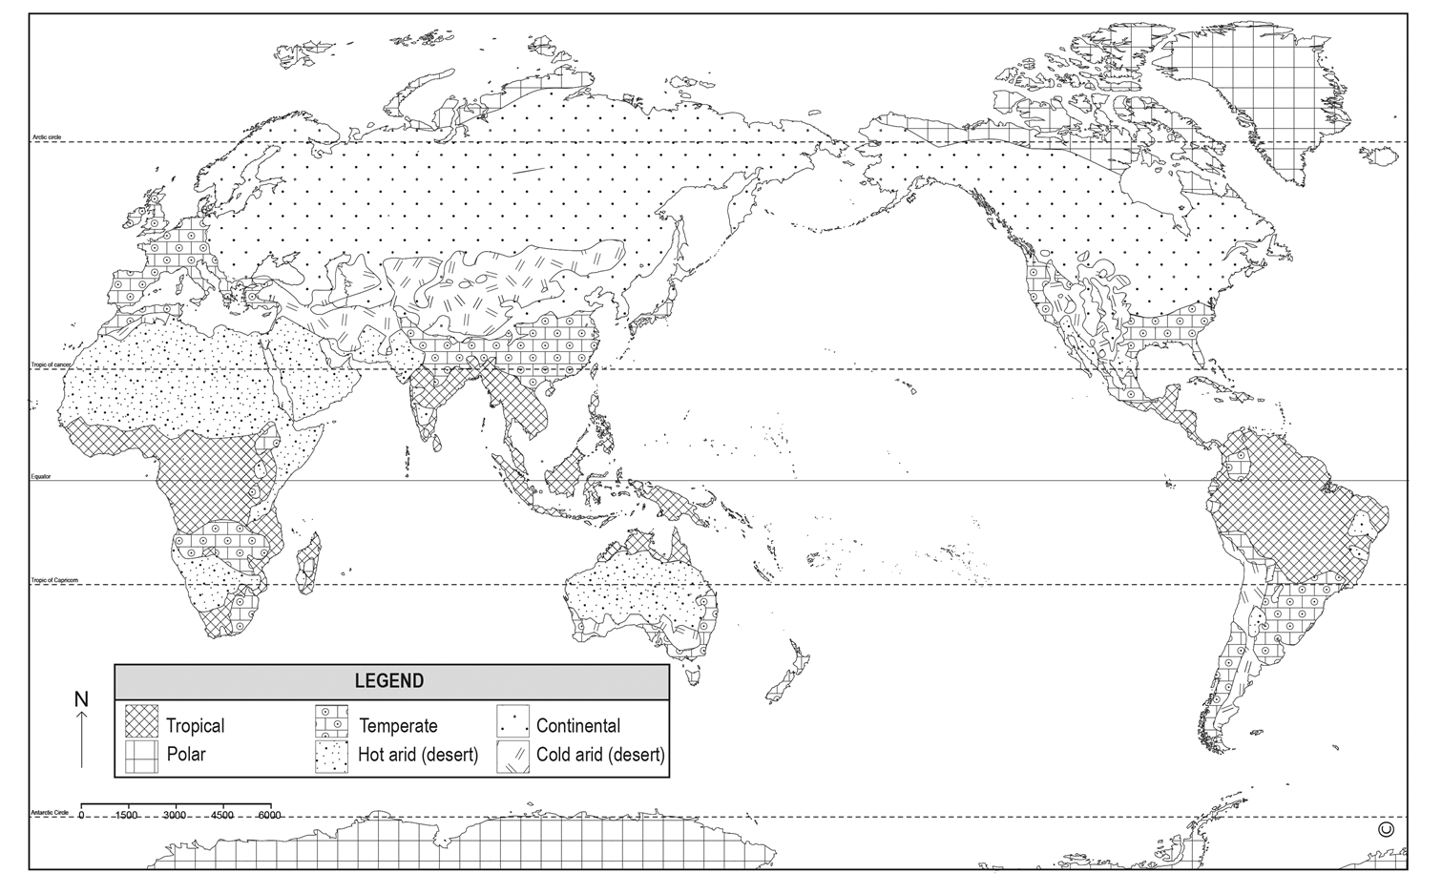

Slide 4
