Slide 1
Population distribution
Where people settle and why.
© Ollie Narbey
www.fishcreek4061.com.au

Slide 2
What is population distribution?
It is the arrangement or spread of people living in a given area.
How people settle in an area is often due to a variety of human and environmental characteristics such as:
access to resources e.g. food, water, hospitals, schools, transport, harbours for shipping, transportation etc
landforms e.g. mountains, lakes, rivers, desert, valleys
climate e.g. extremely hot or cold climates

Slide 3
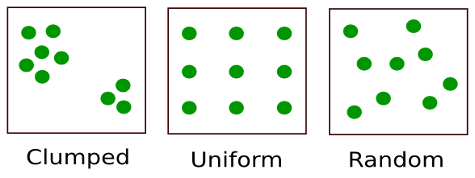
Types of distributions
The population distribution can be described in a number of ways:
clustered (clumped) = many people in a smaller area
dispersed – random or uniform = fewer people in a larger area
linear = people settle in a line pattern
Linear

Slide 4
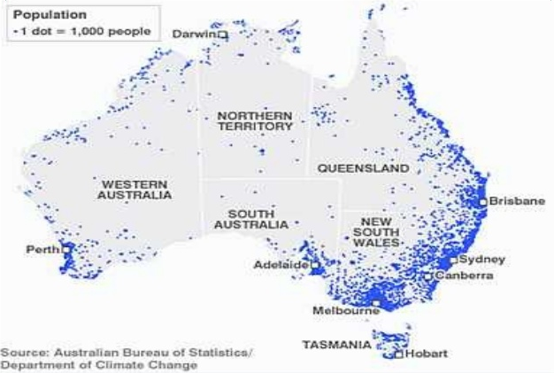
Australian population distribution
Linear distribution along the coast line: could be due to access to harbours, close to beaches (recreation), favourable climate, transportation routes.
Random distribution in the centre of Australia: could be due to limited access to water, resources, harsher climate, desert.
Clustered distribution in major cities: could be due to access to resources, business centres, amenities (hospitals, schools etc).

