Slide 1
The impact people have on the environment

Slide 2
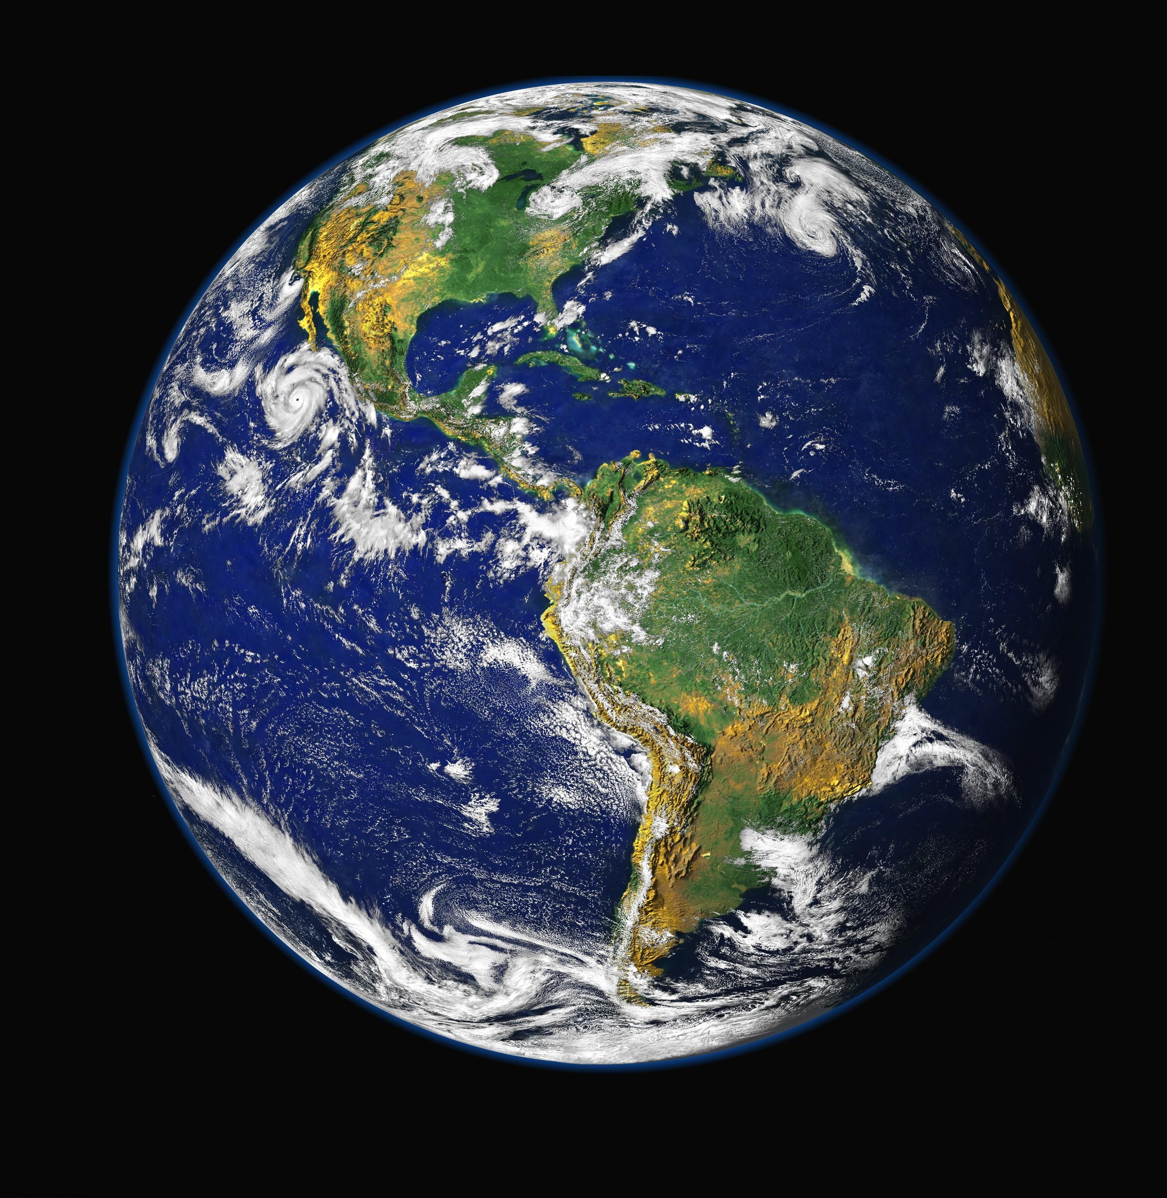
So what has happened over the years?

Slide 3
Well, to start with…. there is a lot of us and we are still increasing in numbers!
Population in 1750: 700 million
Population in 1900: 1.6 billion
Population in 2017: 7.5 billion

Slide 4
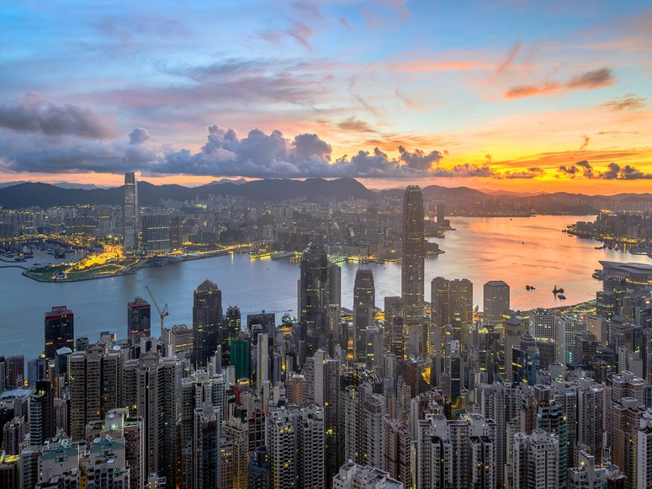
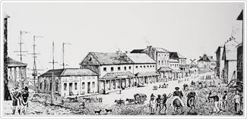
People have settled and cities have grown in size and number

Slide 5
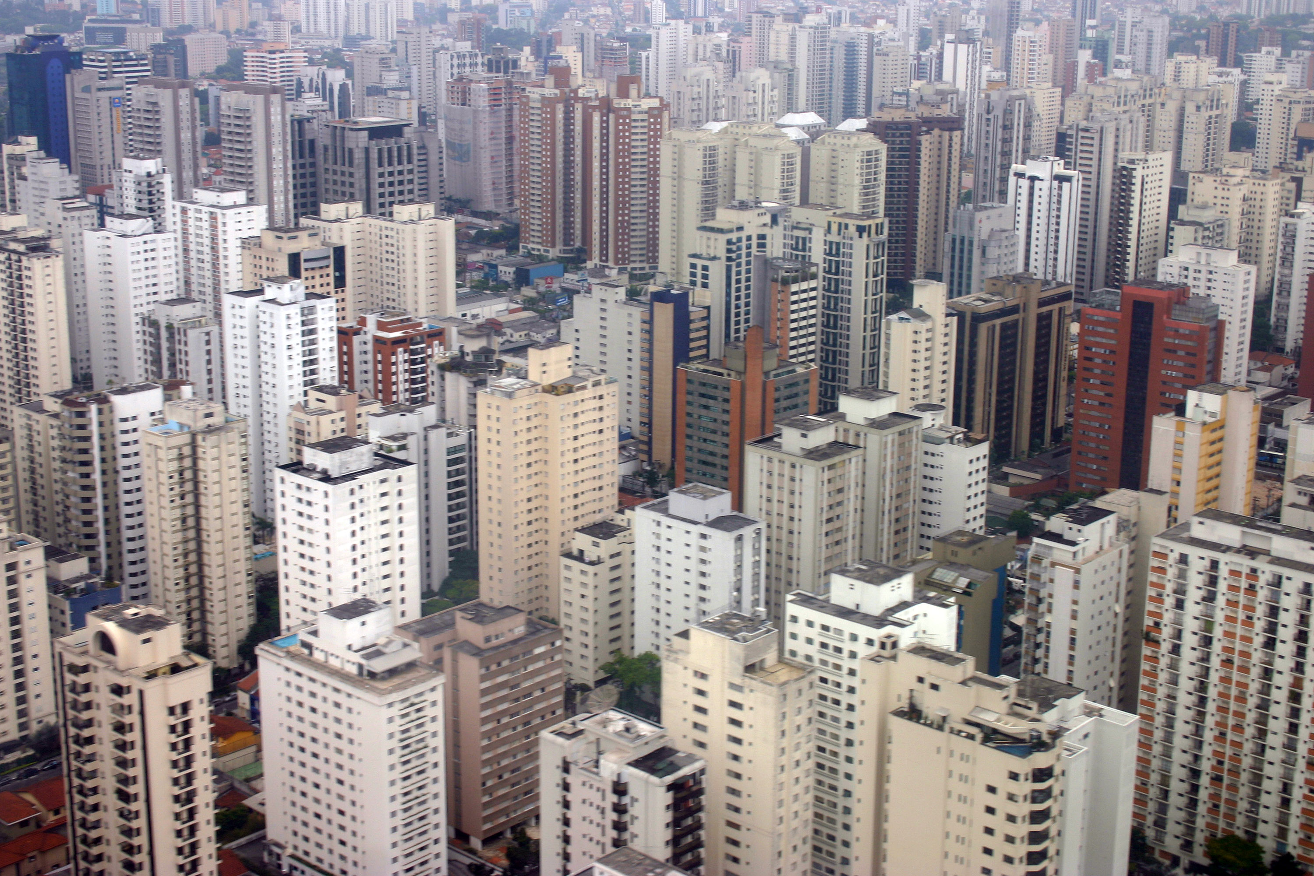

Slide 6
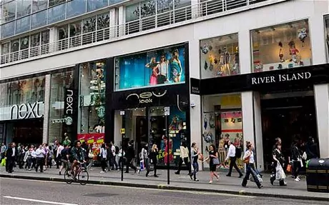
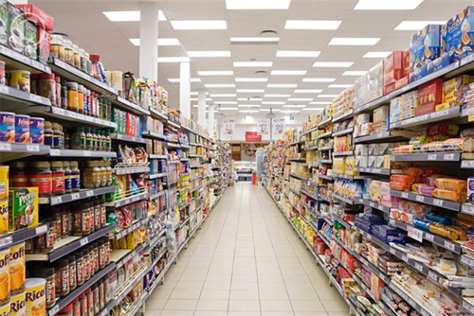
Shops and supermarkets have been built to provide goods to people

Slide 7
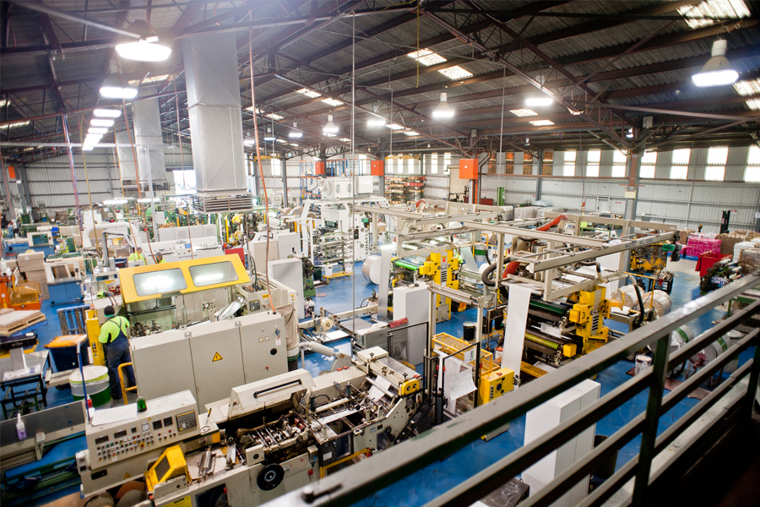
Factories have been built to provide goods for the shops which ultimately provide for the people

Slide 8
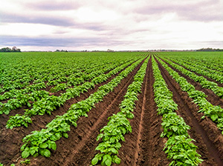
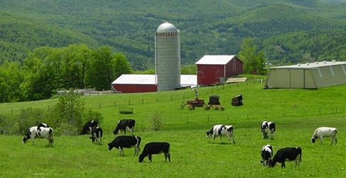
Farms have been established to provide food for the shops which ultimately provide for the people.

Slide 9
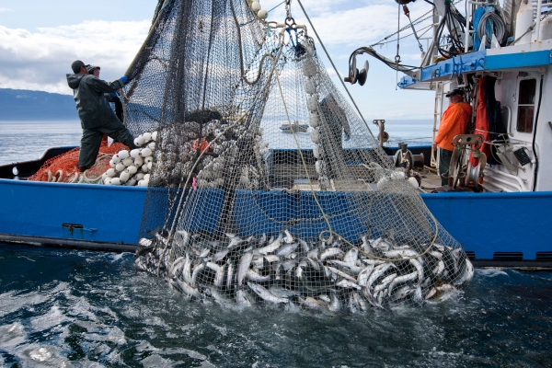
Fisherman trawl the seas to provide food for the shops which ultimately provide for the people.

Slide 10
But unfortunately, with the growth of society there have also been some negative impacts to the environment.

Slide 11
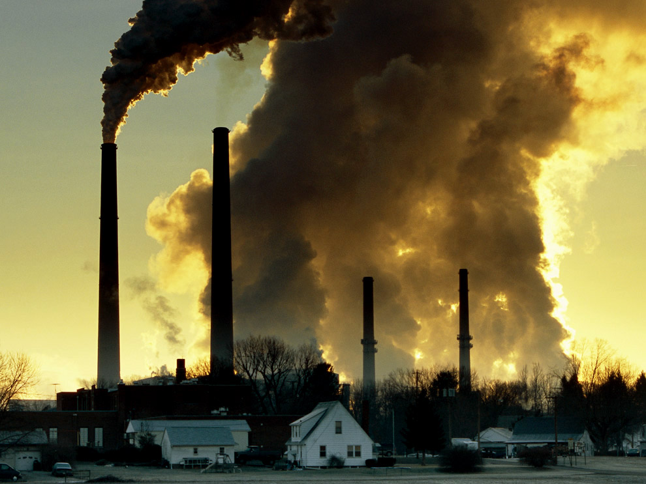
Air pollution

Slide 12
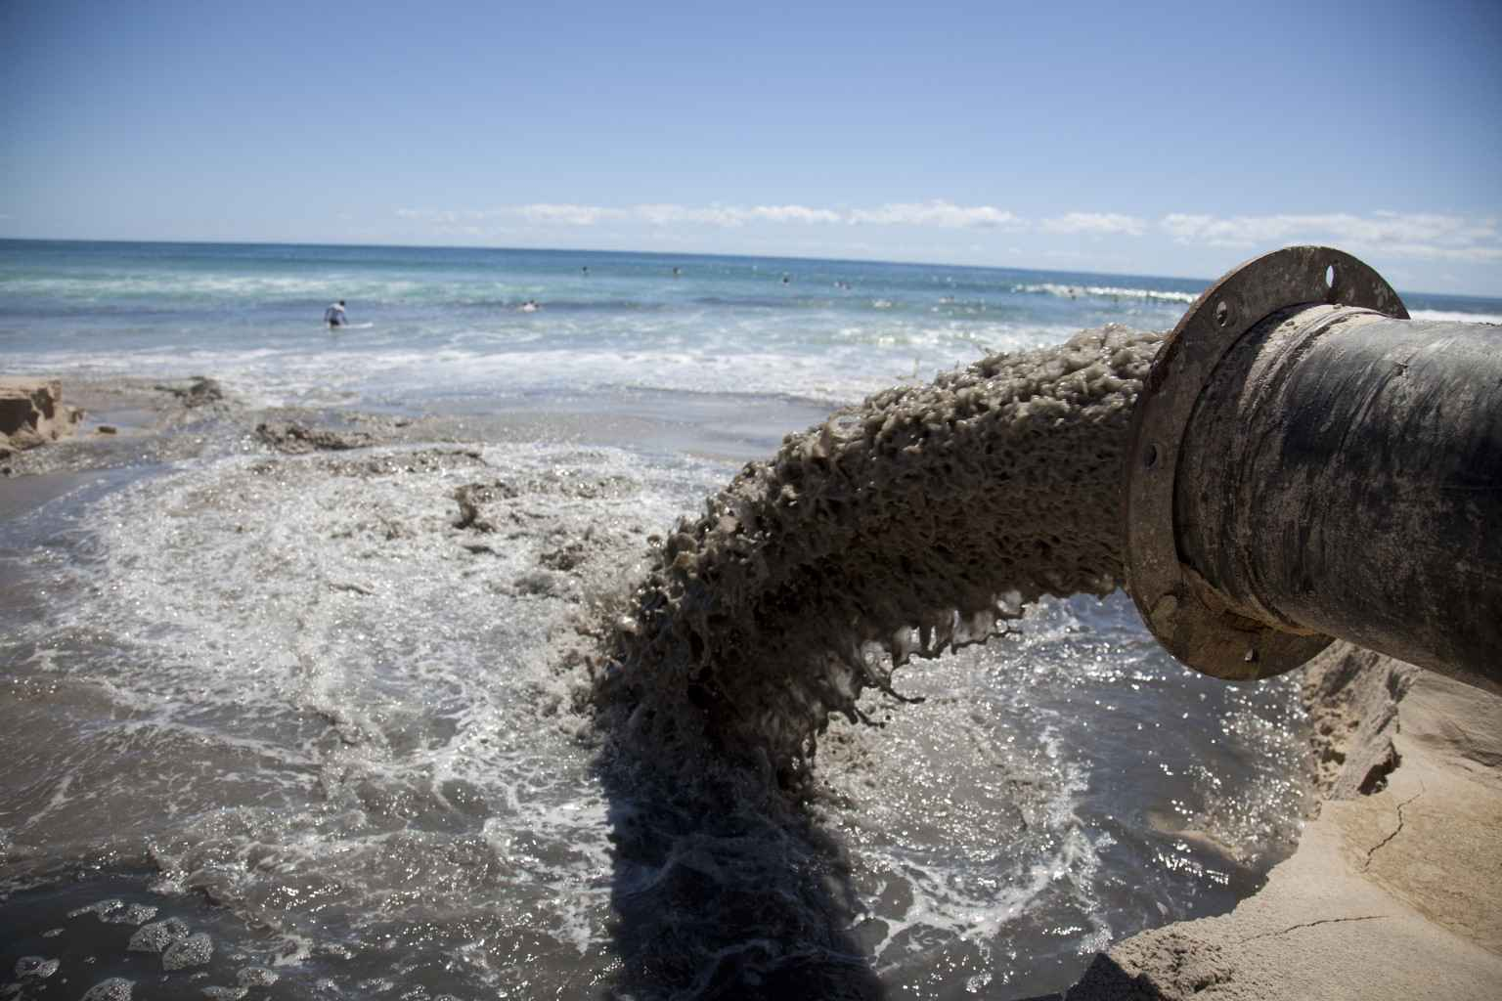
Water pollution

Slide 13
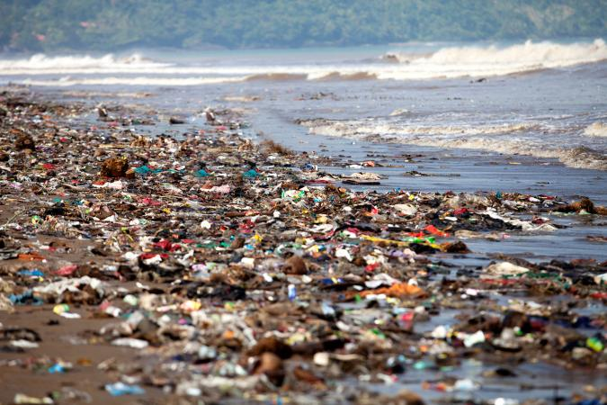
Rubbish on land and water

Slide 14
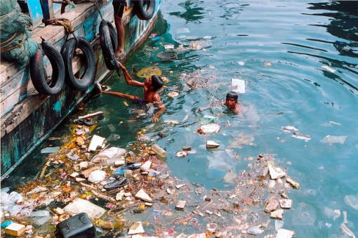
Rubbish in our waterways

Slide 15
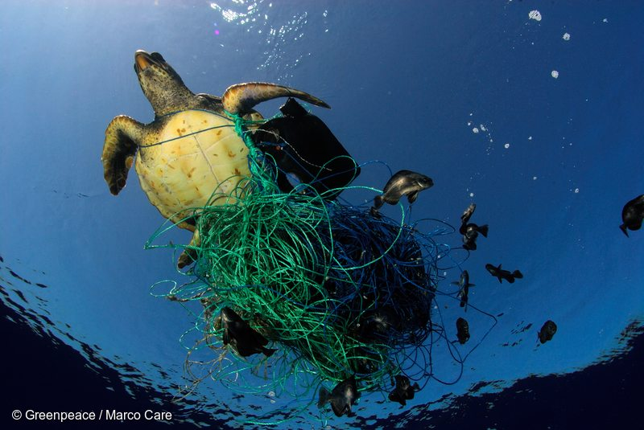
The animals in our water ways suffer from pollution
Fish species are being depleted in large quantities

Slide 16
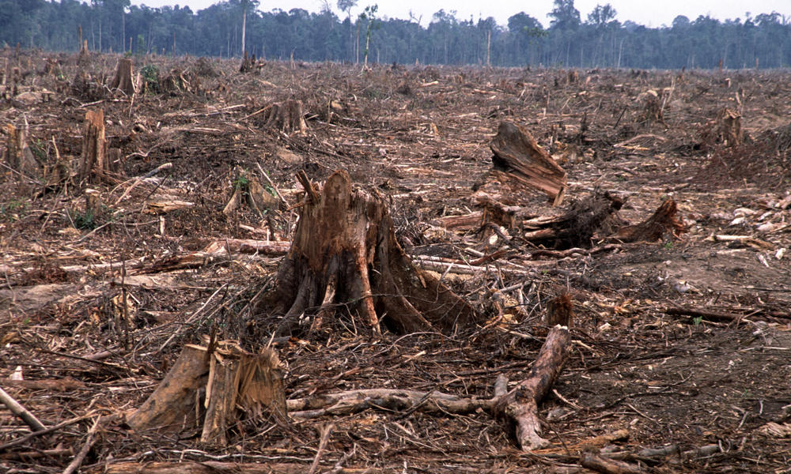
Deforestation

Slide 17
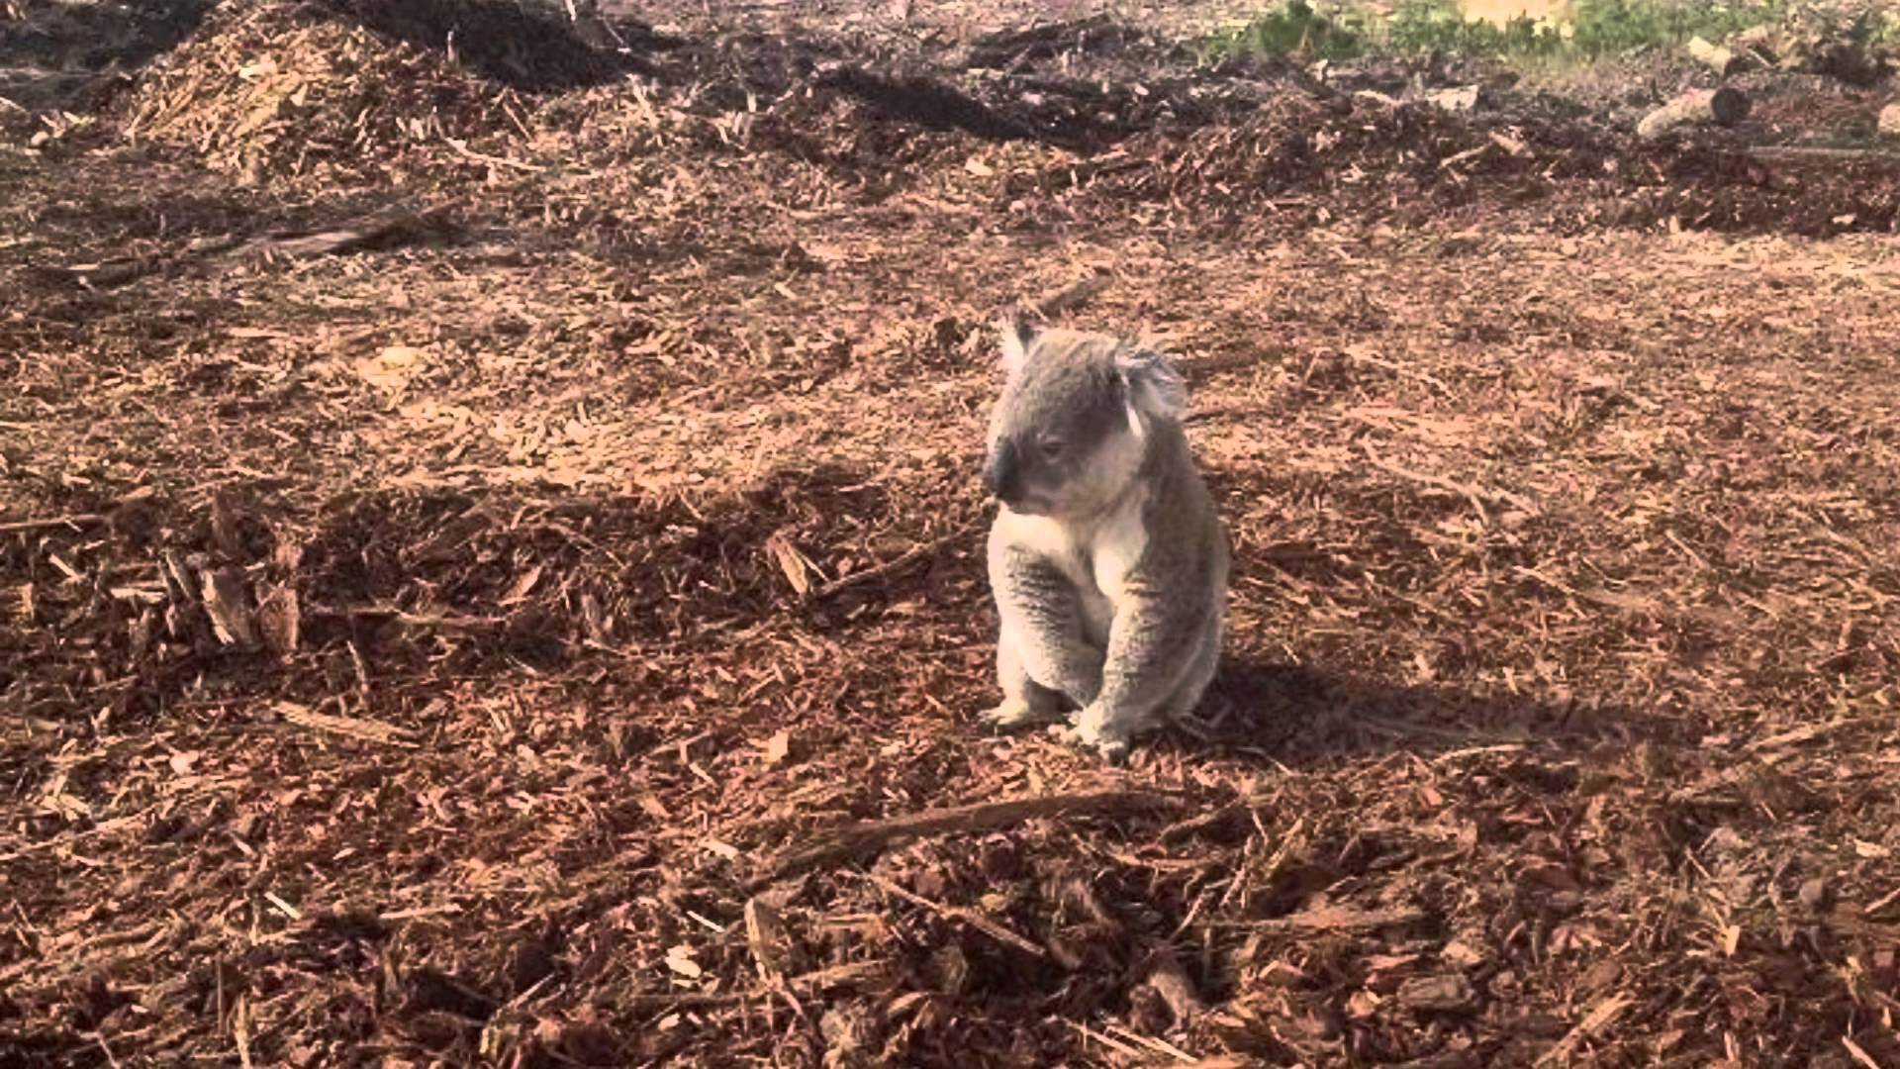
Loss of habitat for animal and plants

Slide 18
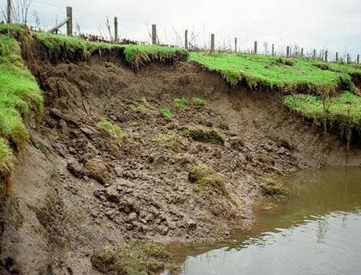
Erosion

Slide 19
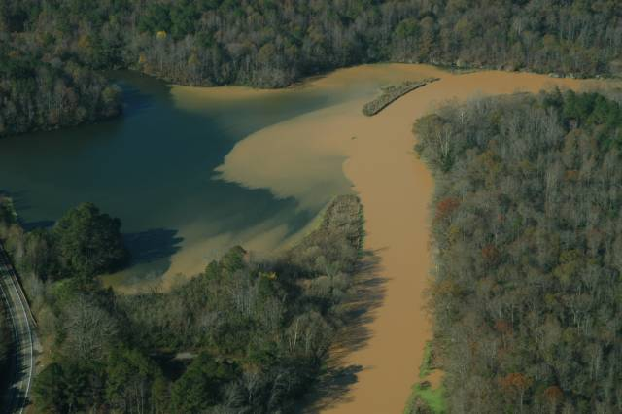
Water pollution due to increased sediment (erosion)

Slide 20
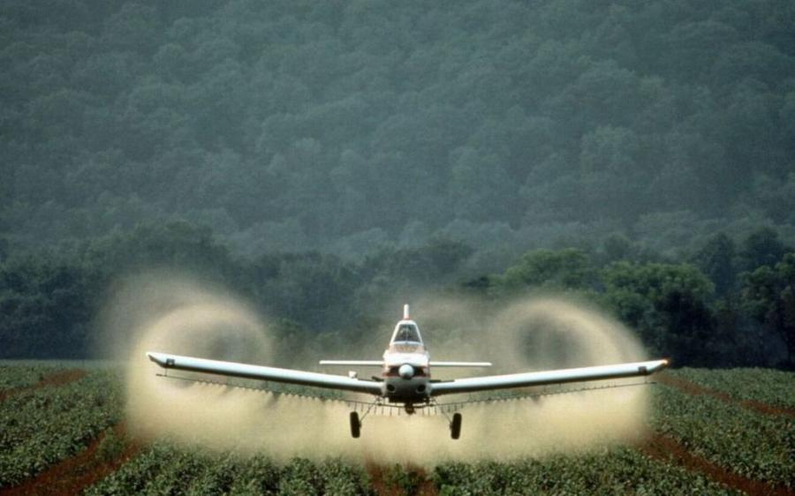
Pollution from fertilisers and pesticides

Slide 21
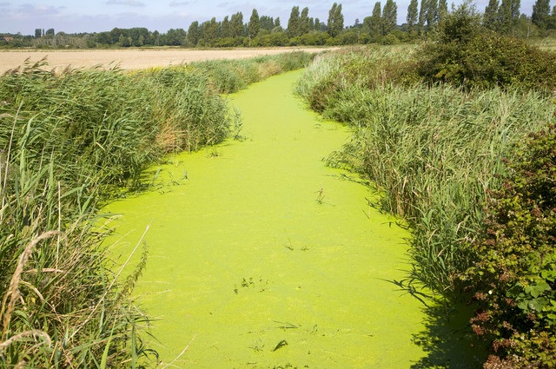
Toxins entering the waterways from spills, farm runoff etc
Toxic algal blooms occurring due to unhealthy waterways

Slide 22
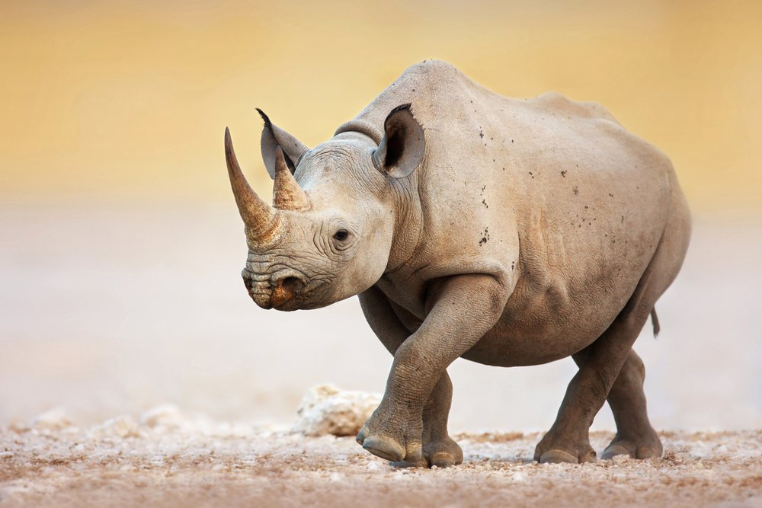
Animals becoming endangered with some at the point of extinction

Slide 23
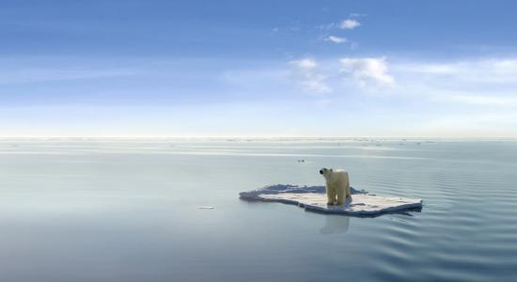
Global warming

Slide 24
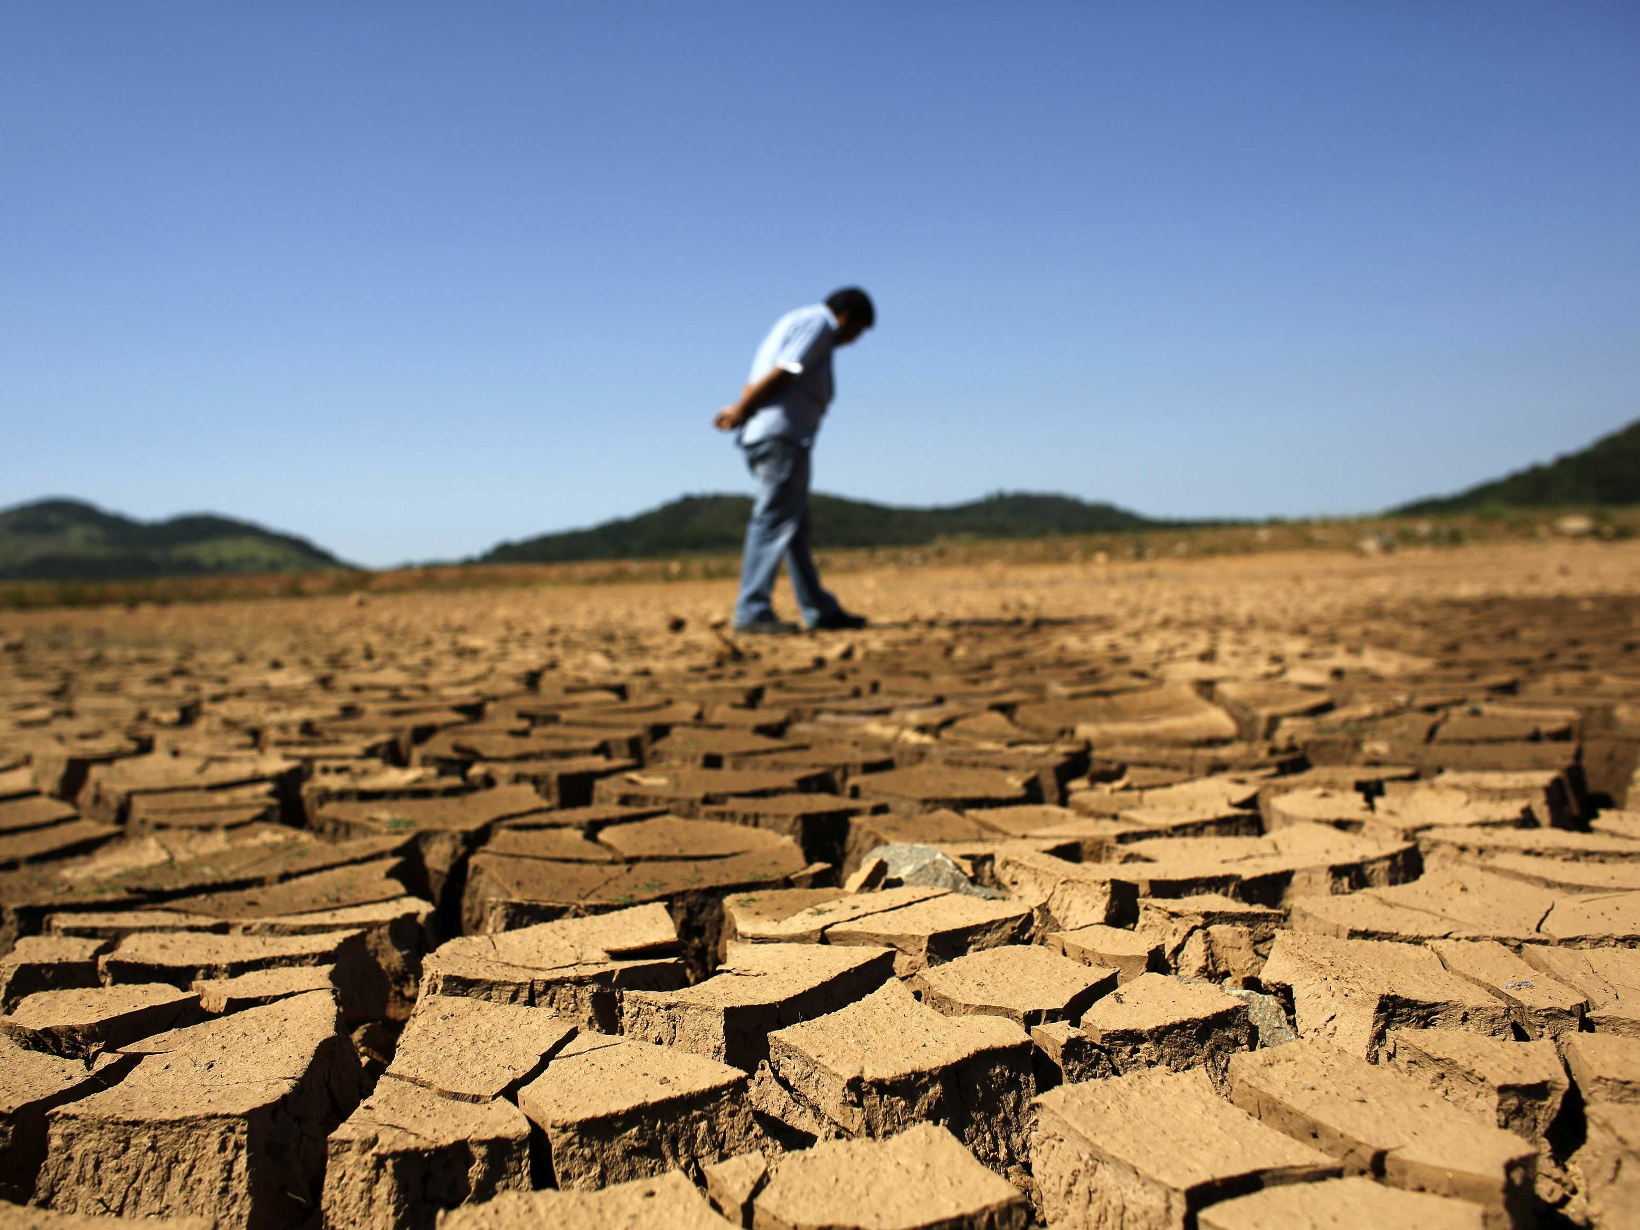
Global warming

Slide 25
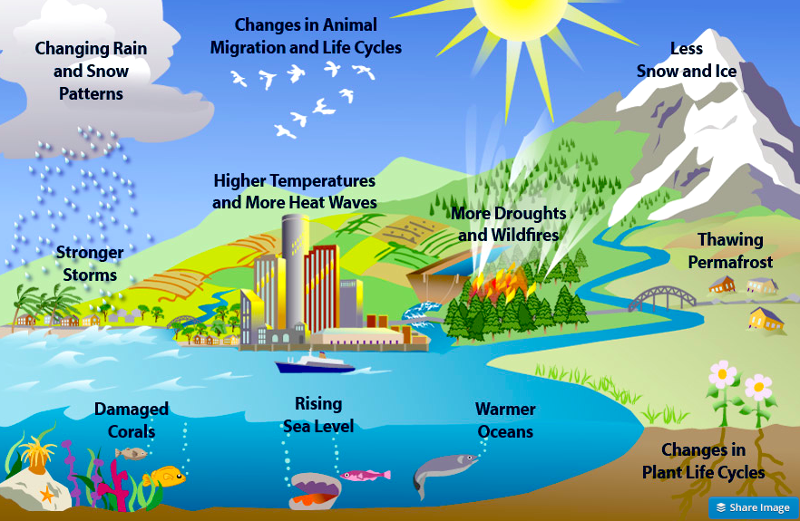
Global warming

Slide 26
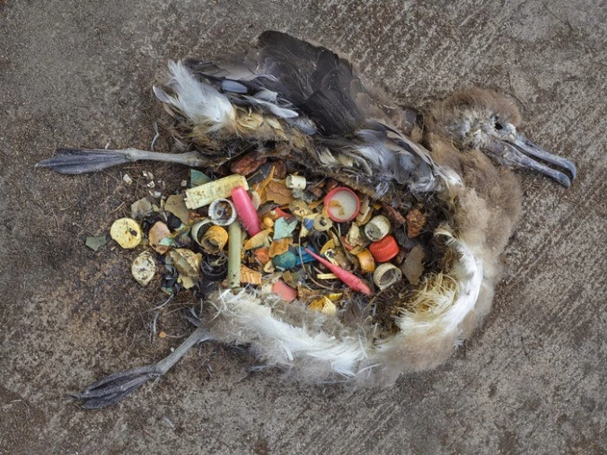
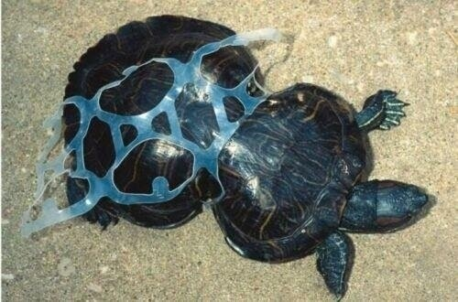
So is it all doom and gloom?

Slide 27
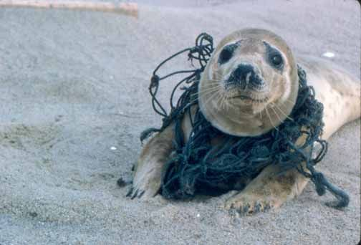
I can’t do anything about it, it is way too big for me to be able to change anything…..
Those animals are far away from here and we don’t really notice global warming either.

Slide 28
You can make a difference!
Every little thing you do can help.
It only takes a tiny change to make a big difference.

Slide 29
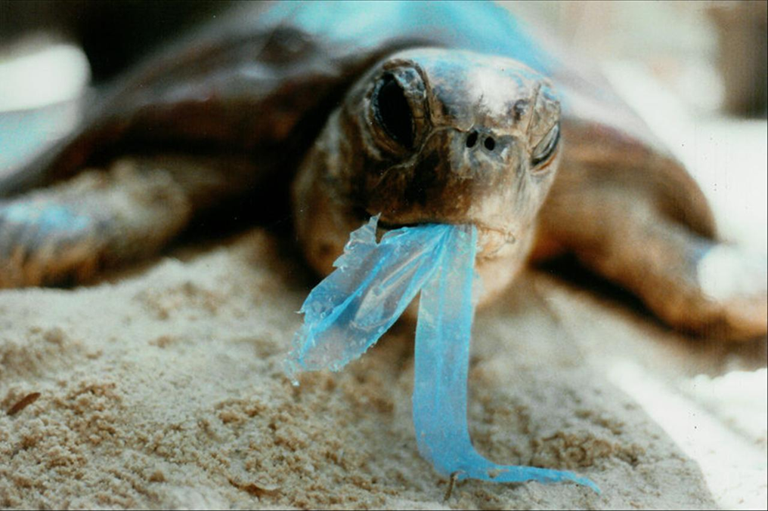
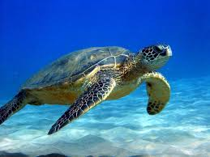
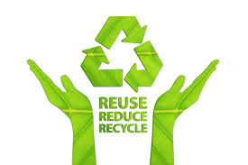
Act local to change global.

